Slide 1
Welcome to CS4141 PSLG!
With Robert and Jakub

Slide 2

Java classes​
Java is an object-oriented programming language.​
Everything in Java is associated with classes and objects, along with its attributes and methods. For example: in real life, a car is an object. The car has attributes, such as weight and color, and methods, such as drive and brake.​
A Class is like an object constructor, or a "blueprint" for creating objects.​
Syntax:​
public class MyClass{​
private int attribute1;​
private String attribute2;​
}​

Slide 3
Problem
Create a car class that has private attributes speed, model and colour.

Slide 4
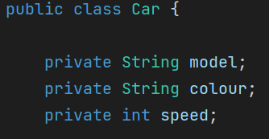
Answer:

Slide 5
What is a constructor​​
A constructor is a special method in a Java class that is called when an object is instantiated.​
It has the same name as the class and does not have a return type.​
Syntax:​
public class MyClass { ​
// Default Constructor ​
public MyClass() { ​
// Initialization code ​
} ​
// Parameterized Constructor ​
public MyClass(int param1, String param2) { ​
// Initialization using parameters ​
}​
}​

Slide 6
Problem
Create a default constructor for the car class that initializes the speed to 0, colour to black and model to Qashqai.
Overload this constructor to take input from the user for the 3 attributes.

Slide 7
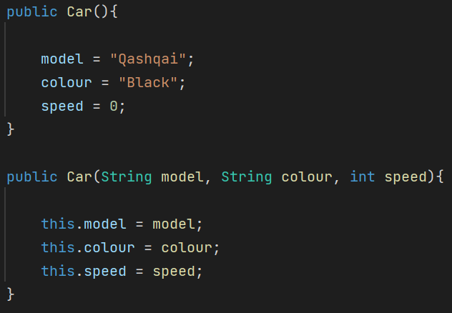
Answer:

Slide 8
What are getters and setters​
Getters:​
Methods used to retrieve the values of private instance variables in a class​
Provide read-only access to the class’s private fields​
public DataType getVariable() { ​
return variable;​
}​
Setters:​
Methods used to modify the values of private instance variables in a class​
Provide a controlled way to update the class’s state​
public void setVariable(DataType newValue) { ​
variable = newValue;​
}​

Slide 9
Problem
Create getter and setter methods for the variables that we have, model, speed and colour.​

Slide 10
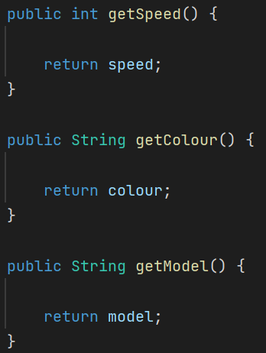
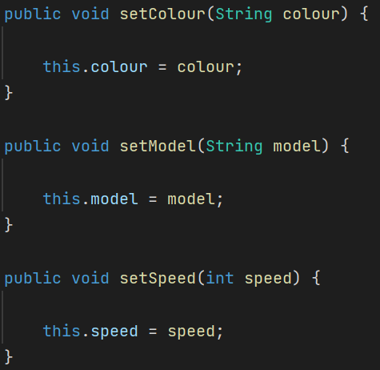
Answer:

Slide 11
Problem
Write accelerator and brake methods which add or subtract 10km/h respectively.​

Slide 12
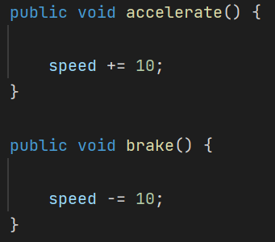
Answer:

Slide 13
Thank you for coming!

